Slide 1
THE ASSAULT
on
FREEDOM TO TEACH
&
FREEDOM TO LEARN
FLORIDA
BANNED BOOKS

Slide 2
BOOK BANNING
“Banning ideas and authors is not a ‘culture war’
. . . it’s fascism”
Yale Professor Jason Stanley
The Guardian 2023

Slide 3
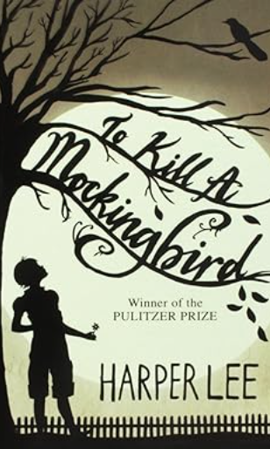
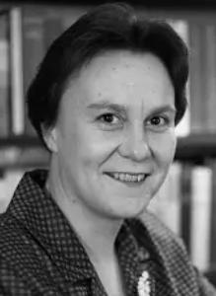
FLORIDA BANNED BOOKS
To Kill a Mockingbird
Harper Lee
1960 | First published
1961 | Pulitzer Prize
1972 | Presidential Medal of Freedom (George Bush)
2019 | “100 most influential novels” (BBC News)
2020 | “Top five” checkouts of the NY Public Library
FL. MAGA G.O.P.
Author Harper Lee
Banned: School District of Palm Beach County
“Banning ideas and authors is not a ‘culture war’ – it’s fascism”
Prof. Jason Stanley (2023)”

Slide 4
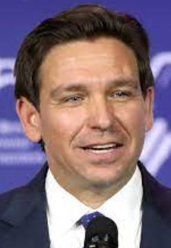
FLORIDA’S ASSAULT ON LGBTQ+ STUDENTS
(2022)
“DON’T SAY GAY” BILL
HB 1557/SB 1834
Signed March 2022
Bans classroom discussions related to sexual orientation and gender identity in schools.
SILENCES LGBTQ+ STUDENTS
Bars LGBTQ+ students from talking about their own lives, experiences, and families and denies their very existence.
2. SILENCES STUDENT’S SPEECH
Silences students from speaking about their LGBTQ+ family members, friends, neighbors, and icons.
3. BARS SCHOOL LGBTQ+ SUPPORT
The dangerously vague provisions in the bill chills school support for LGBTQ+ youth by creating new costly liabilities for school districts.
Fascist’s attack vulnerable minorities
igniting hate and intolerance.
4. EMPOWER BIGOTS
Allows intolerant parents unsupportive of a. district's policies to sue for damages and attorney's fees
SOURCE: ACLU FLORIDA 2024

Slide 5
FLORIDA’S ASSAULT ON LGBTQ+ STUDENTS
(2023)
“DON’T SAY GAY” EXPANSION BILL
HB 1069
Signed May 2023
Bans books with sexual
content.
BANS BOOKS DEPICTING SEXUAL CONDUCT
The bill also allows anyone in the district to object to material that depicts any sexual conduct, even if it is not pornographic, if it is not for a health course.
DENIES TRANS PEOPLE’S EXISTENCE
Requires sex ed programs to teach that sex is determined by reproductive function at birth and is binary and unchangeable and to use only materials approved by the state Department of Education.
Fascist’s attack vulnerable minorities
igniting hate and intolerance.
SOURCE: ACLU FLORIDA 2024

Slide 6
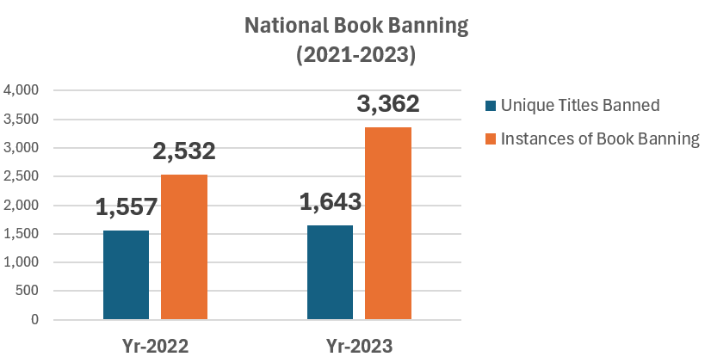
THE RISE IN BOOK BANNING IN AMERICA
There has been a 33% spike in book bans nationally, and Florida now accounts for more than
40%
of all documented bans.
Unique
Unique
Source: Penn America 2023
“Banning ideas and authors is not a ‘culture war’ – it’s fascism”
Prof. Jason Stanley (2023)”

Slide 7
BOOK BAN DEFINITION
BOOK BANS
A school book ban is any action taken against a book based on its content and as a result of . . . . . .
parent or community challenges
administrative decisions
threats from lawmakers or other government officials
. . . . that leads to a previously available book being completely removed from availability to students, or where access to a book is restricted or diminished.
“Banning ideas and authors is not a ‘culture war’ – it’s fascism”
Prof. Jason Stanley (2023)”

Slide 8
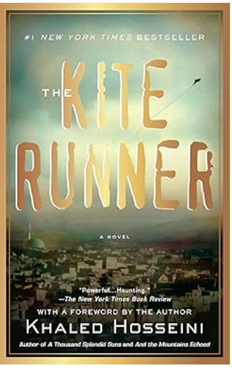
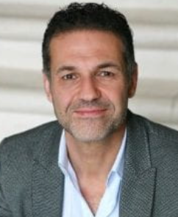
FLORIDA BANNED BOOKS
The Kite Runner
Khaled Hosseini
2003 – Book first published.
First Lady Laura Bush praised The Kite Runner as "really great“
Book translated into 42 languages for publication in 38 countries.
FL. MAGA G.O.P.
Khaled Hosseini
The #1 New York Times bestselling novel beloved by millions of readers the world over.
Banned: Okaloosa County Schools
“Banning ideas and authors is not a ‘culture war’ – it’s fascism”
Prof. Jason Stanley (2023)”

Slide 9
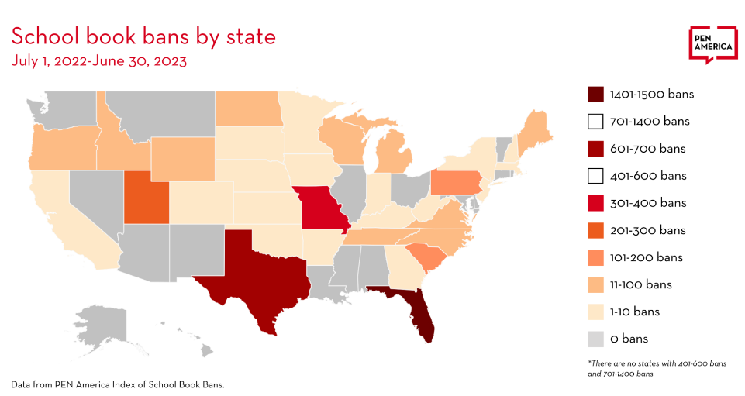
BOOK BANNING
TEXAS #2
FLORIDA #1
“Banning ideas and authors is not a ‘culture war’ – it’s fascism”
Prof. Jason Stanley (2023)”

Slide 10
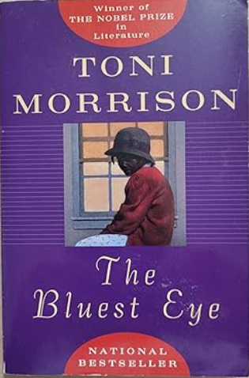
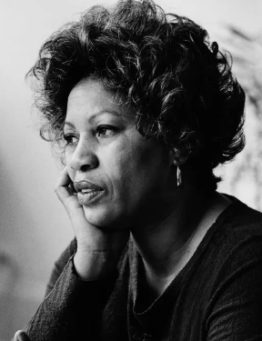
FLORIDA BANNED BOOKS
The Bluest Eye
Toni Morrison
1970 | First published
1993 | Morrison receives the Nobel Prize
FL. MAGA G.O.P.
“The Bluest Eye” was reported by the A.L.A as the 10th most banned book 2010-2019
Toni Morrison
Banned: Polk County Schools
“Banning ideas and authors is not a ‘culture war’ – it’s fascism”
Prof. Jason Stanley (2023)”

Slide 11
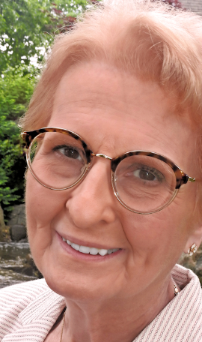
BANNED BOOKS
“To be told your books can’t be on display or that your books are inappropriate because they simply reflect your life and experiences… it’s not only an act of censorship but an act of violence to the community.”
— Deborah Caldwell-Stone
Deborah Caldwell-Stone is the Director of the American Library Association's Office for Intellectual Freedom.
“Banning ideas and authors is not a ‘culture war’ – it’s fascism”
Prof. Jason Stanley (2023)”

Slide 12
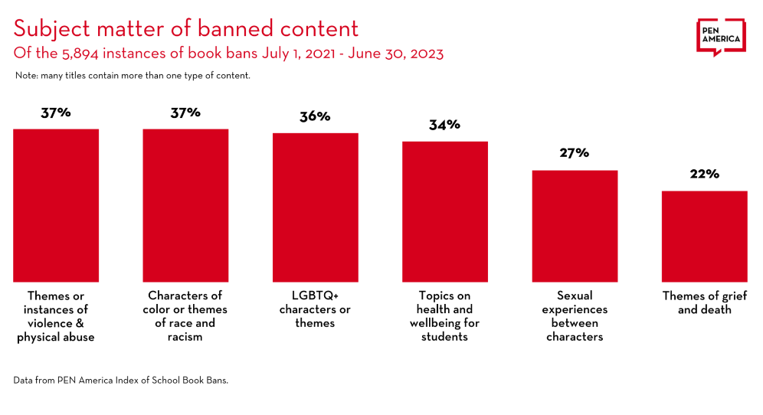
BOOK BAN REASONS
Reason for Ban | %
Instances of violence; abuse | 37%
Characters of color; racism | 37%
LGBTQ+ characters or themes | 36%
Topics of health or student well-being | 34%
Sexual experiences between characters | 27%
Themes of grief and death | 22%
Subject matter banned content of the 5,894 instances of books banned nationally
July 1, 2021 – June 30, 2023
Note: Many titles contain more than one type of content
“Banning ideas and authors is not a ‘culture war’ – it’s fascism”
Prof. Jason Stanley (2023)”

Slide 13
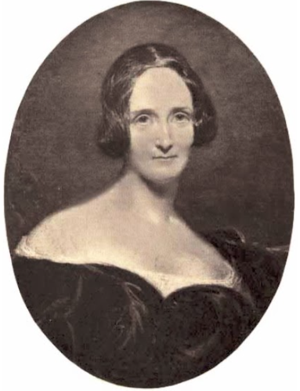
FLORIDA BANNED BOOKS
Frankenstein
Mary Shelley
1818 | First published
2019 | “One the “100 most influential novels” (BBC list)
FL. MAGA G.O.P.
“Today, the novel is generally considered to be a landmark work as one of the greatest Romantic and Gothic novels, as well as one of the first science fiction novels.”
Wikipedia
Mary Shelley
Banned: Gilchrist County Schools
“Banning ideas and authors is not a ‘culture war’ – it’s fascism”
Prof. Jason Stanley (2023)”

Slide 14
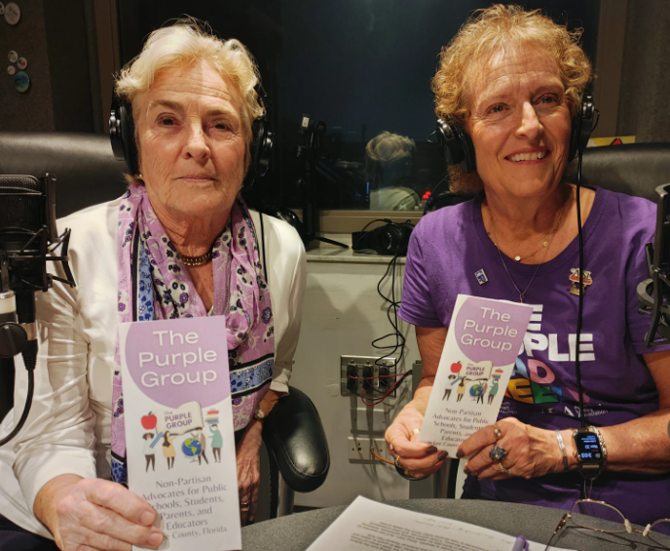
THE PURPLE GROUP
(Lee County Florida Activist Group)
PARENTAL RIGHTS
“We believe all parents have the right to make educational decisions for their own students.” . . .
HOWEVER
“Other parents should never be allowed to restrict the rights of another parents’ student.”
The PURPLE GROUP
Madelon Stewart & Marge Cox
“Banning ideas and authors is not a ‘culture war’ – it’s fascism”
Prof. Jason Stanley (2023)”

Slide 15
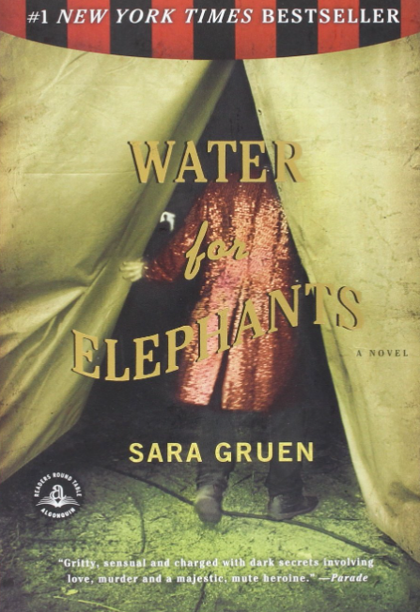
FLORIDA BANNED BOOKS
Water for Elephants
Sara Gruen
2006 | First published
2006 | Quill Award nominee
2007 | Alex Awards selection
2007 | Entertainment Weekly “Best Novel of 2006 nominee.”
2007 | No. 1 best NY Times Bestseller list July 2007
FL. MAGA G.O.P.
Sara Gruen
Banned in Highland Schools
In the dark of night, Jacob jumps on a train, later learning it is a circus train belonging to the Benzini Brothers Most Spectacular Show on Earth. . . .
“Banning ideas and authors is not a ‘culture war’ – it’s fascism”
Prof. Jason Stanley (2023)”

Slide 16
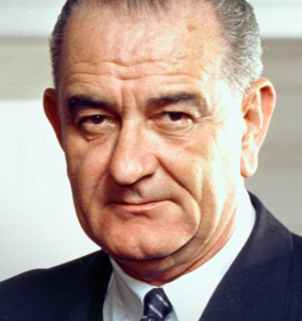
FLORIDA BANNED BOOKS
"Books and ideas are the most effective weapons against intolerance and ignorance.”
Lyndon B Johnson
11 Feb. 1964
“Banning ideas and authors is not a ‘culture war’ – it’s fascism”
Prof. Jason Stanley (2023)”

Slide 17
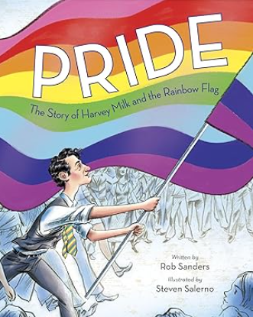
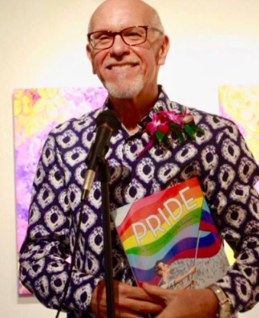
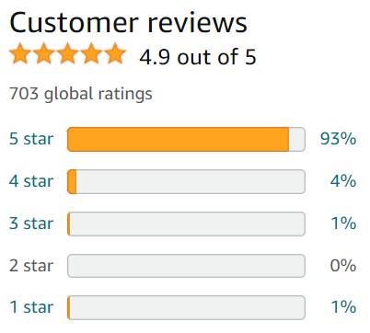
FLORIDA BANNED BOOKS
Pride: The Story of Harvey Milk and the Rainbow Flag
Rob Sanders
2018 | First published
FL. MAGA G.O.P.
Rob Sanders
Banned: Martin County Schools
“Banning ideas and authors is not a ‘culture war’ – it’s fascism”
Prof. Jason Stanley (2023)”

Slide 18
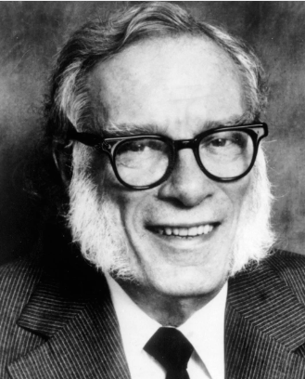
FREEDOM TO LEARN
“Any book worth banning is a book worth reading.” ―Isaac Asimov
Asimov won more than a dozen annual awards for particular works of science fiction and a half-dozen lifetime awards. He also received 14 honorary doctorate degrees from universities. – Wikipedia.
Isaac Asimov
Science Fiction Author
“Banning ideas and authors is not a ‘culture war’ – it’s fascism”
Prof. Jason Stanley (2023)”

Slide 19
FREEDOM TO LEARN
(American Library Association)
BANNED BOOK WEEK
Sponsored annually by the ALA since the 1980’s (last week of September).
Celebrates the “Freedom to Learn.”
Promotes access to all ideas, even those some may consider untraditional or unpopular.
“Banning ideas and authors is not a ‘culture war’ – it’s fascism”
Prof. Jason Stanley (2023)”

Slide 20
FLORIDA BANNED BOOKS
The Hate U Give
Angie Thomas
2017 | First published
2017-2018 | Winner: Waterstone Goodread’s Choice Award Edgar Award Audie Award Finalist: Kirkus Prize Nat’l Book Award LA Times Book Award
Booklist name the book one of the best of the year (2017) of any genre.
FL. MAGA G.O.P.
Angie Thomas
Banned: Jackson County School District
“Banning ideas and authors is not a ‘culture war’ – it’s fascism”
Prof. Jason Stanley (2023)”

Slide 21
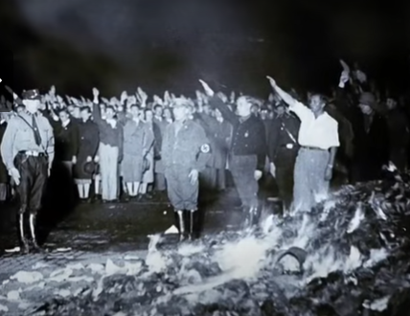
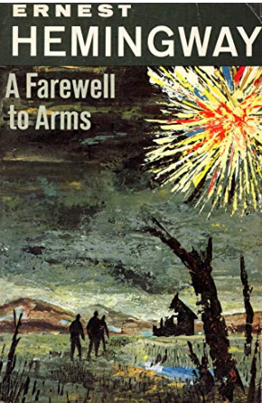
NAZIS BAN and BURN BOOKS
NAZI ASSAULT ON AUTHORS AND IDEAS
The burning of books under the Nazi regime on May 10, 1933, is perhaps the most famous book burning in history.
In a symbolic act of ominous significance, on May 10, 1933, university students burned upwards of 25,000 volumes of “un-German” books, presaging an era of state censorship and control of culture.
Books burned by the NAZIS in 1930s
“Banning ideas and authors is not a ‘culture war’ – it’s fascism”
Prof. Jason Stanley (2023)”

Slide 22
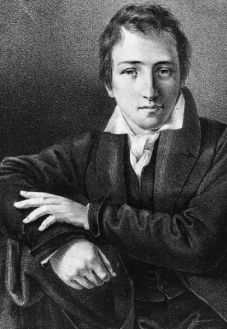
BOOK BURNING
“Where they burn books, in the end, they will burn humans too.”
NAZI 1930s
Books Banned & Burned by the NAZIS - 1935
1833
1843
Heinrich Heine – German Poet
1821
“Banning ideas and authors is not a ‘culture war’ – it’s fascism”
Prof. Jason Stanley (2023)”

Slide 23
FLORIDA HORRIFIC ASSAULT
On PUBLIC EDUCATION
Prohibits certain content in schoolbooks and library books
Draconian punishment for schools, administrators and teachers
Empowers a parent to restrict access to books of other’s children
“Banning ideas and authors is not a ‘culture war’ – it’s fascism”
Prof. Jason Stanley (2023)”

Slide 24
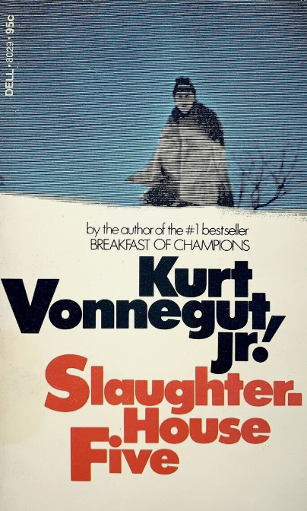
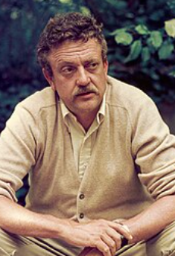
FLORIDA BANNED BOOKS
Slaughter-House Five
Kurt Vonnegut, Jr.
1969 | Book first published
1970 | Nominated best novel Hugo and Nebula award Included in Time Magazine’s 100 best novels since 1923
FL. MAGA G.O.P.
Kurt Vonnegut, Jr.
In 1973, the head of the school board of a North Dakota district declared the novel inappropriate to teach, citing the obscene language.
Each copy of Vonnegut's novel in the school was burned in the furnace.
Banned: Brevard Public Schools
“Banning ideas and authors is not a ‘culture war’ – it’s fascism”
Prof. Jason Stanley (2023)”

Slide 25
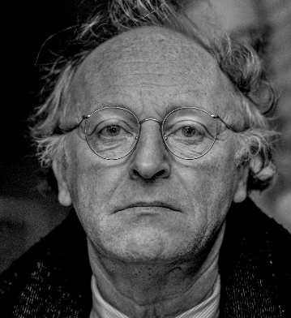
FLORIDA BANNED BOOKS
“There are worse crimes than burning books. One of them is not reading them.”
Joseph Brodsky
1987 – Nobel Prize for Literature
1992 – US Poet Laureate
Joseph Brodsky
“Banning ideas and authors is not a ‘culture war’ – it’s fascism”
Prof. Jason Stanley (2023)”

Slide 26
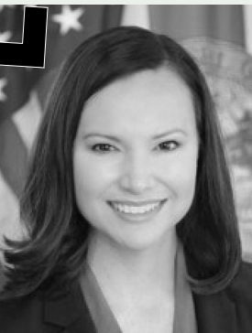
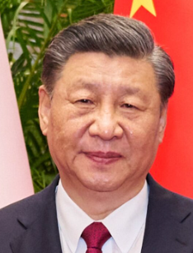
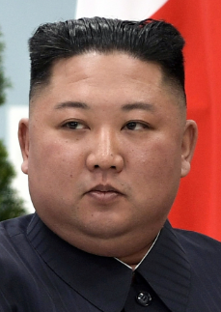
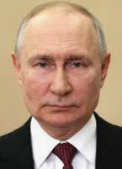
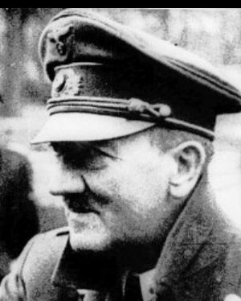
The FASCIST PERSPECTIVE
DESANTIS CLAIMS “PROTECTED
GOVERNMENT SPEECH”
It’s a contention that First Amendment experts and advocates call extreme and chilling.
.
Public school libraries are “a forum for government speech,” Moody says, not a “forum for free expression.”
“Public-school systems, including their libraries, convey the government’s message,”
Legal brief: Fla. Attorney General Ashley Moody
THESE MEN WOULD AGREE
Ashley Moody
DeSantis
FL Attorney General
“Banning ideas and authors is not a ‘culture war’ – it’s fascism”
Prof. Jason Stanley (2023)”

Slide 27
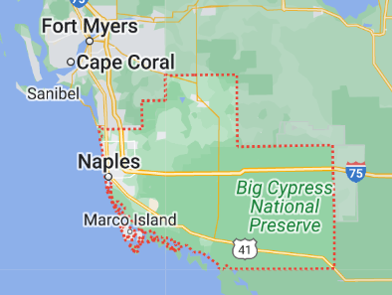
LITERARY CLASSICS BANNED
in COLLIER CO.
Banned literary classics:
The Man in the Iron Mask, by Alexandre Dumas
Shōgun, by James Clavell
Ceremony, by Leslie Marmon Silko
Invisible Man, by Ralph Ellison
Catch-22, by Joseph Heller
Brave New World, by Aldous Huxley
On the Road, by Jack Kerouac
Flowers for Algernon, by Daniel Keyes
Their Eyes Were Watching God, by Zora Neale Hurston
The Executioner’s Song, by Norman Mailer
A Good Man is Hard to Find And Other Stories, by Flannery O’Connor
Atlas Shrugged and The Fountainhead, by Ayn Rand
Slaughterhouse-Five, by Kurt Vonnegut Jr.
Anna Karenina, by Leo Tolstoy
The Color Purple and The Temple of My Familiar, by Alice Walker
The Once and Future King, by T.H. White
FL. MAGA G.O.P.
Collier County
Banned: Collier County Schools
Source: Penn America – Jonathan Friedman, Nov. 2023

Slide 28
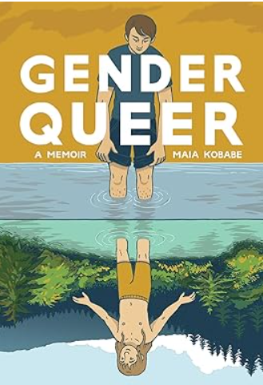
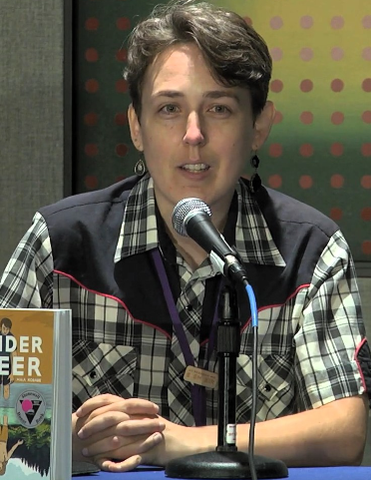
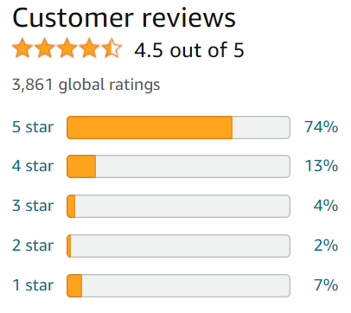
FLORIDA BANNED BOOKS
Gender Queer: A Memoir
Maia Kobabe
FL. MAGA G.O.P.
Maia Kobabe
2019
The crusade against “Gender Queer” has largely driven its popularity . . .
The memoir has sold more than 96,000 copies and has been translated into multiple languages.
Banned: Brevard Public Schools
“Banning ideas and authors is not a ‘culture war’ – it’s fascism”
Prof. Jason Stanley (2023)”

Slide 29
FLORIDA BANNED BOOKS
‘My school is 96% white.
How else are these students going to become empathetic humans?
They have to know about other races and identities.”
“People are saying they [conservative groups] are trying to protect children from pornography in school,”
. . . but it’s false outrage.
They’re targeting LGBTQ and other marginalized communities.”
Source: Amanda Jones
LA Times, Dec 21, 2022
Amanda Jones
Librarian in Louisiana
Harassed for supporting LGBTQ books
“Banning ideas and authors is not a ‘culture war’ – it’s fascism”
Prof. Jason Stanley (2023)”

Slide 30
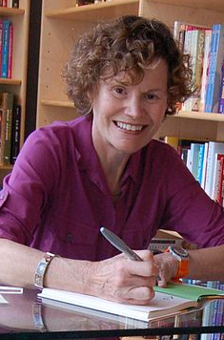
FLORIDA BANNED BOOKS
“Let children read whatever they want and then talk about it with them.
If parents and kids can talk together, we won't have as much censorship because we won't have as much fear.”
― Judy Blume
Judy Blume
Author - Children and young adult books
Named one of the 100 most influential
people in the world by Time magazine in 2023.
“Banning ideas and authors is not a ‘culture war’ – it’s fascism”
Prof. Jason Stanley (2023)”

Slide 31
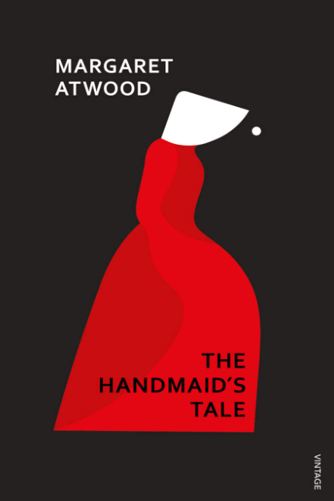
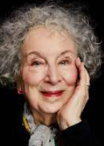
FLORIDA BANNED BOOKS
The Handmaid’s Tale
Margaret Atwood
1985 | Book first published
1986-1987 | Winner: Arthur C. Clarke Award LA Times Fiction Award Nominated: Booker Prize Nebula Award Prometheus Award
FL. MAGA G.O.P.
Margaret Atwood
UNBURNABLE COPY OF BOOK
SOLD FOR $130,000 (2022)
“To those who seek to stop young people from reading The Handmaid’s Tale: Good luck with that. It’ll only make them want to read it more.”
– Atlantic, Feb 2023
Banned: Hamilton County School District
“Banning ideas and authors is not a ‘culture war’ – it’s fascism”
Prof. Jason Stanley (2023)”

Slide 32
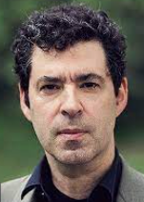
FREEDOM TO LEARN
(American Library Association)
Indoctrination …. takes places by banning ideas.
Celebrating the banning of authors and concepts as “freedom from indoctrination” is as Orwellian as politics gets. “
Source: The Guardian, Feb 2023
Jason Stanley
“Banning ideas and authors is not a ‘culture war’ – it’s fascism”
Prof. Jason Stanley (2023)”

Slide 33
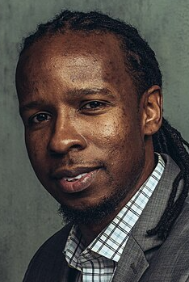
UNDERSTANDING RACISM
How To Be An Antiracist
Ibram X. Kendi - 2019
“Remember, we are all either racists or antiracists.”
How to be an Antiracist
Chapter 11, pp. 143
FL. MAGA G.O.P.
Banned: Clay County School District
“Banning ideas and authors is not a ‘culture war’ – it’s fascism”
Prof. Jason Stanley (2023)”

Slide 34
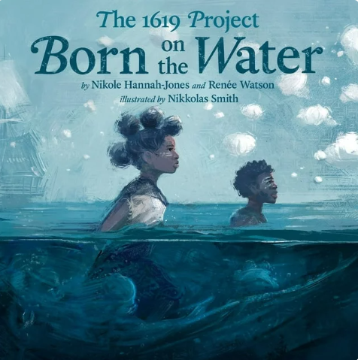
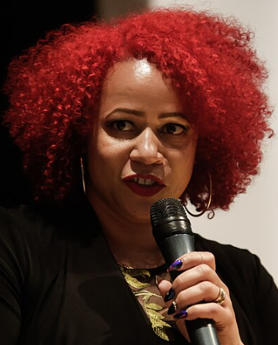
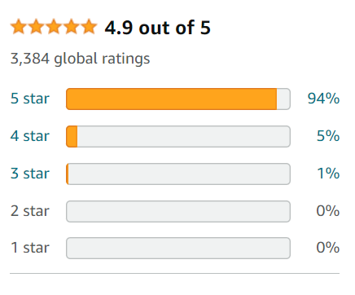
FLORIDA BANNED BOOKS
Born on the Water
The 1619 Project
Nicole Hannah-Jones
2021 | Book first published
FL. MAGA G.O.P.
Nicole Hannah-Jones
Pulitzer Prize Winner
The 1619 Project’s picture book in verse chronicles the consequences of slavery and the history of Black resistance in the U.S.,
Banned: Palm Beach County School District
“Banning ideas and authors is not a ‘culture war’ – it’s fascism”
Prof. Jason Stanley (2023)”

Slide 35
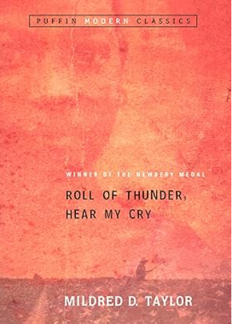
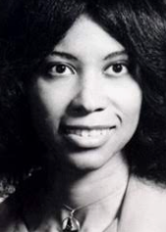
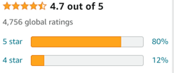
FLORIDA BANNED BOOKS
Roll of Thunder, Hear My Cry
Mildred D. Taylor
1976 | Book first published
1977 | Newbery Medal Nat’l Book Award finalist
FL. MAGA G.O.P.
Mildred D. Taylor
At age of nine, author Ayana Mathis wrote of Taylor’s novel,
"I not only learned what it meant to live a perilous life, surrounded by open hostility, but I also made the grim discovery that such circumstances even existed.”
Wikipedia.
Banned: Martin County Schools
“Banning ideas and authors is not a ‘culture war’ – it’s fascism”
Prof. Jason Stanley (2023)”

Slide 36
AUTHORITARIANS BAN BOOKS
CENSORSHIP IN THE SOVIET UNION
In the past . . . censors in the U.S.S.R. banned anti-Soviet books, books about sex, LGBT, religion and other many topics.
The novel "Doctor Zhivago" by Boris Pasternak was deemed anti-Soviet for not toeing the party line on the 1917 Revolution and could not be printed in Russia.
Nobel Prize 1958
Source: The Moscow Times
May 16, 2023
“Banning ideas and authors is not a ‘culture war’ – it’s fascism”
Prof. Jason Stanley (2023)”

Slide 37
CHINA BANS BOOKS
Hong Kong removes hundreds of politically sensitive books from public libraries
Source: Radio Free Asia, 5-16-2023
A survey of the Hong Kong public library catalog by RFA's Cantonese Service found that around 250 titles had disappeared . . . three times as many as during a similar operation in 2021.
Hong Kong authorities have removed hundreds of books from the shelves of the city's public libraries in recent week..
Includes books referencing the 1989 Tiananmen massacre that ended weeks of pro-democracy protests around China.
“Banning ideas and authors is not a ‘culture war’ – it’s fascism”
Prof. Jason Stanley (2023)”

Slide 38
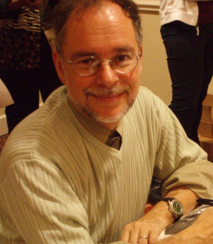
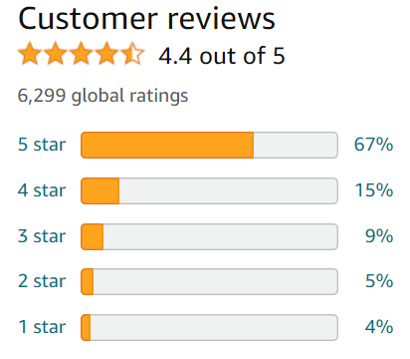
FLORIDA BANNED BOOKS
Wicked: The Life and Times of the Wicked Witch of the West
Gregory Maguire
1995 | First published
FL. MAGA G.O.P.
Gregory Maguire
Maguire helps the reader understand how "an innocent if rather green and biting child" can become “ … a moralistic terrorist. – Ness Mari 2010.
Banned: Okaloosa County Schools
“Banning ideas and authors is not a ‘culture war’ – it’s fascism”
Prof. Jason Stanley (2023)”

Slide 39
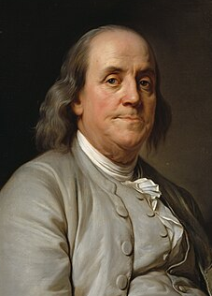
FLORIDA BANNED BOOKS
“If all printers were determined not to print anything till they were sure it would offend nobody, there would be very little printed.”
— Benjamin Franklin
“Banning ideas and authors is not a ‘culture war’ – it’s fascism”
Prof. Jason Stanley (2023)”

Slide 40
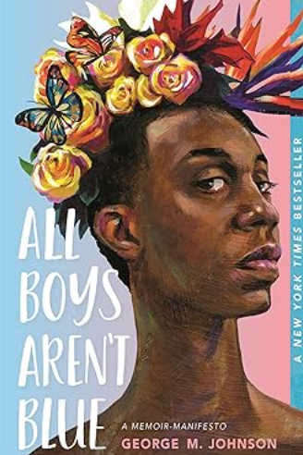
FLORIDA BANNED BOOKS
All Boys Aren’t Blue
George M. Johnson
2020 | First published
It was removed from libraries in eight states due to claims of "sexual obscenity" for its descriptions of queer sex and masturbation.
As of November 2021, All Boys Aren't Blue was one of the most frequent targets of book bans and challenges amid an "unprecedented" period of book banning according to ALA.
FL. MAGA G.O.P.
George M. Johnson
Banned: Indian River School District
“Banning ideas and authors is not a ‘culture war’ – it’s fascism”
Prof. Jason Stanley (2023)”

Slide 41
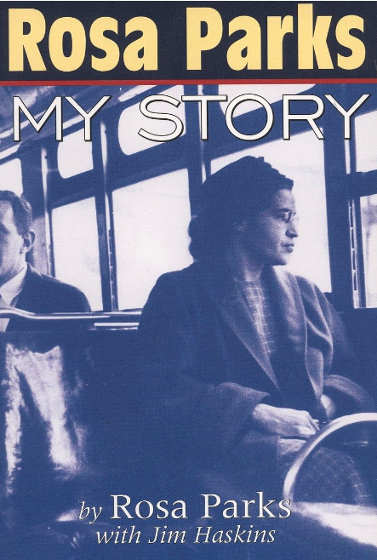
FLORIDA BANNED BOOKS
Rosa Parks
Jim Haskins
1992 | First published
FL. MAGA G.O.P.
Jim Haskins
Haskins’ children’s picture books tend to highlight the achievements of African Americans in society.
Banned: Volusia County Schools
“Banning ideas and authors is not a ‘culture war’ – it’s fascism”
Prof. Jason Stanley (2023)”

Slide 42
TOTALITARIAN STATES
BAN IDEAS, AUTHORS & BOOKS
“Banning books in public schools is a dangerous infringement on students’ First Amendment right to access information,” said Jenna Leventoff, Senior Policy Counsel, American Civil Liberties Union.
“Robust and diverse school libraries are critical to ensuring that all students, regardless of their family’s income, education, race, or geographic location, have free and open access to the vast world of information each book contains.
A C L U
Jenna Leventoff
American Civil Liberties Union
“Banning ideas and authors is not a ‘culture war’ – it’s fascism”
Prof. Jason Stanley (2023)”

Slide 43
DICTIONARIES BANNED?
FLORIDA SCHOOLS REMOVE DICTIONARIES FROM LIBRARIES
Wait, did Florida ban the dictionary? Why one county is pulling Merriam-Webster from shelves
Claire Thornton
USA TODAY – Jan 12, 2024
A Florida school district last month pulled the Merriam-Webster dictionary from library shelves to comply with a state law banning books with descriptions of "sexual conduct.”
OXFORD DICTIONARY
sex·u·al in·ter·course
/ˈsekSH(o͞o)əl ˈin(t)ərˌkôrs/
Noun
sexual contact between individuals involving penetration, especially the insertion of a man's erect penis into a woman's vagina, typically culminating in orgasm and the ejaculation of semen.
FL. MAGA G.O.P.
Banned: Escambia County School District
“Banning ideas and authors is not a ‘culture war’ – it’s fascism”
Prof. Jason Stanley (2023)”

Slide 44
BOOK BANNING
“Banning books gives us silence when we need speech. It closes our ears when we need to listen. It makes us blind when we need sight.”
―Stephen Chbosky
Stephen Chbosky is an American film director, screenwriter, and author
iStock
ID:469734046
kycw
“Banning ideas and authors is not a ‘culture war’ – it’s fascism”
Prof. Jason Stanley (2023)”

Slide 45
RELIGIOUS BANNING OF IDEAS
“What is freedom of expression? Without the freedom to offend, it ceases to exist.”
―Salman Rushdie
“The attack on books, the attack on teaching, the attack on libraries, in – how can I put this – Florida, has never been more dangerous, never been more important to fight.”
Salman Rushdie – May 2023
Salman Rushdie
“Banning ideas and authors is not a ‘culture war’ – it’s fascism”
Prof. Jason Stanley (2023)”

Slide 46
FLORIDA BANNED BOOKS
The Complete Maus: A Survivor’s Tale
Art Spiegelman
1991 | Published 1980 – 1991
1992 1992 | Pulitzer Prize LA Times – Book Prize for Fiction
FL. MAGA G.O.P.
Art Spiegelman
Banned: Polk County Public Schools
“Banning ideas and authors is not a ‘culture war’ – it’s fascism”
Prof. Jason Stanley (2023)”

Slide 47
FLORIDA BANNED BOOKS
Brave New World
Aldous Huxley
1932 | Published
In 1999, the Modern Library ranked Brave New World fifth on its list of the 100 best English-language novels of the 20th century
FL. MAGA G.O.P.
Aldous Huxley
"A masterpiece. ... One of the most prophetic dystopian works." —Wall Street Journal
Banned: Collier Public Schools
“Banning ideas and authors is not a ‘culture war’ – it’s fascism”
Prof. Jason Stanley (2023)”

Slide 48
TOTALITARIAN STATES
BAN IDEAS, AUTHORS & BOOKS
And librarians are on the front lines, fighting every day to make the widest possible range of viewpoints, opinions, and ideas available to everyone.
“Today, some of the books that shaped my life and the lives of so many others — are being challenged by people who disagree with certain ideas or perspectives.
Barack Obama
“Banning ideas and authors is not a ‘culture war’ – it’s fascism”
Prof. Jason Stanley (2023)”

Slide 49
FLORIDA BANNED BOOKS
The Color Purple
Alice Walker
1982 | Published
1983 1983 | Pulitzer Prize National Book Award for Fiction
FL. MAGA G.O.P.
Commonly cited justifications for banning the book include sexual explicitness, explicit language, violence, and homosexuality.
Alice Walker
Banned: Orange County School District
“Banning ideas and authors is not a ‘culture war’ – it’s fascism”
Prof. Jason Stanley (2023)”

Slide 50
BANNING IDEAS, AUTHORS & BOOKS
“Censorship is the child of fear and the father of ignorance.”
Types of books banned nationally,
(July 1, 2021-Jun 30, 2023)
61%
22%
Laurie Halse Anderson
Author: Young Adult Novels
11%
4%
<1%
Young Adult
Adult
Middle
Grade
Picture
Book
Chapter
Book
“Banning ideas and authors is not a ‘culture war’ – it’s fascism”
Prof. Jason Stanley (2023)”

Slide 51
BANNING IDEAS, AUTHORS & BOOKS
“The important task of literature is to free man, not to censor him . . .
. . . and that is why Puritanism was the most destructive and evil force which ever oppressed people and their literature: it created hypocrisy, perversion, fears, sterility.”
Anais Nin
“Banning ideas and authors is not a ‘culture war’ – it’s fascism”
Prof. Jason Stanley (2023)”

Slide 52
FLORIDA BANNED BOOKS
Extremely Loud and Incredibly Close
Jonathan Safran Foer
2005 | Book first published
FL. MAGA G.O.P.
Jonathan Safran Foer
REASON FOR BANNING THIS BOOK?
A single, sexual passage that's tangential at best to the book's central theme.
Philadelphia Citizen Podcast – Oct. 2023
Banned: Polk County Public Schools
“Banning ideas and authors is not a ‘culture war’ – it’s fascism”
Prof. Jason Stanley (2023)”

Slide 53
AUTHORS BANNED NATIONALLY
“I’m always sorry that people ban my books. Many times I’ve been called the most banned. Many times my books are banned by people who never read two sentences.” — Maya Angelou
Maya Angelou 1974
“Banning ideas and authors is not a ‘culture war’ – it’s fascism”
Prof. Jason Stanley (2023)”

Slide 54
FLORIDA BANNED BOOKS
Anne Frank’s Diary: The Graphic Novel
Ari Folman
2017 | First published
FL. MAGA G.O.P.
Ari Folman
This first graphic edition of The Diary includes extensive quotations directly from the definitive edition.
Banned: Jackson County School District
“Banning ideas and authors is not a ‘culture war’ – it’s fascism”
Prof. Jason Stanley (2023)”

Slide 55
STATEMENT ON BOOK BANNING
“Book banning erodes our democracy, removes vital resources for student learning, and can contribute to the stigma and isolation that LGBTQIA+ people and other communities face.”
President Biden White House Statement
June 2023
“Banning ideas and authors is not a ‘culture war’ – it’s fascism”
Prof. Jason Stanley (2023)”

